Slide 1
CMon
Multi-Domain Circuit Monitoring Tool
Trupti Kulkarni
Product Manager, GÉANT
NSI Meeting - TNC 2015, Porto
17 June, 2015

Slide 2

Agenda
Introduction & Motivation
CMon
Architecture
Example of a Provisioning System
Information Workflow
Design Considerations
Current Status
Future Plans, Conclusion

Slide 3
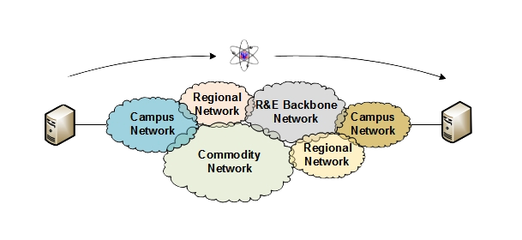
Introduction & Motivation
Resources are often distributed, big
Users, data, etc.
Services and applications
Federated, multi-domain
Global research demands
Infrastructure: Reliable, robust, secure
Connections: dedicated, high-bandwidth, less jitter
Result: bigger networks
Technology, size, geographical locations

Slide 4
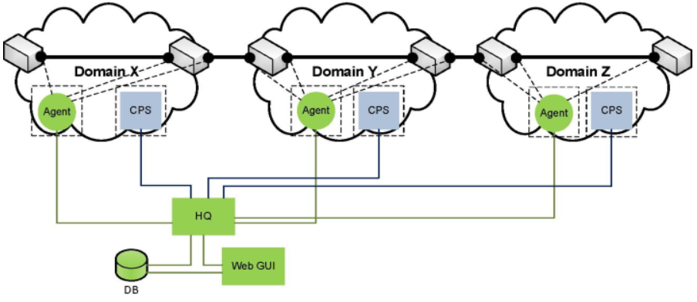
CMon
Unified platform for multi-domain circuit monitoring
Different methods for monitoring
From SNMP to interface to local NMS – for circuit availability
perfSONAR – for performance measurements
Complete view of monitoring data
Fetches monitoring data from domains and splices different segment performances to show for the whole connection

Slide 5
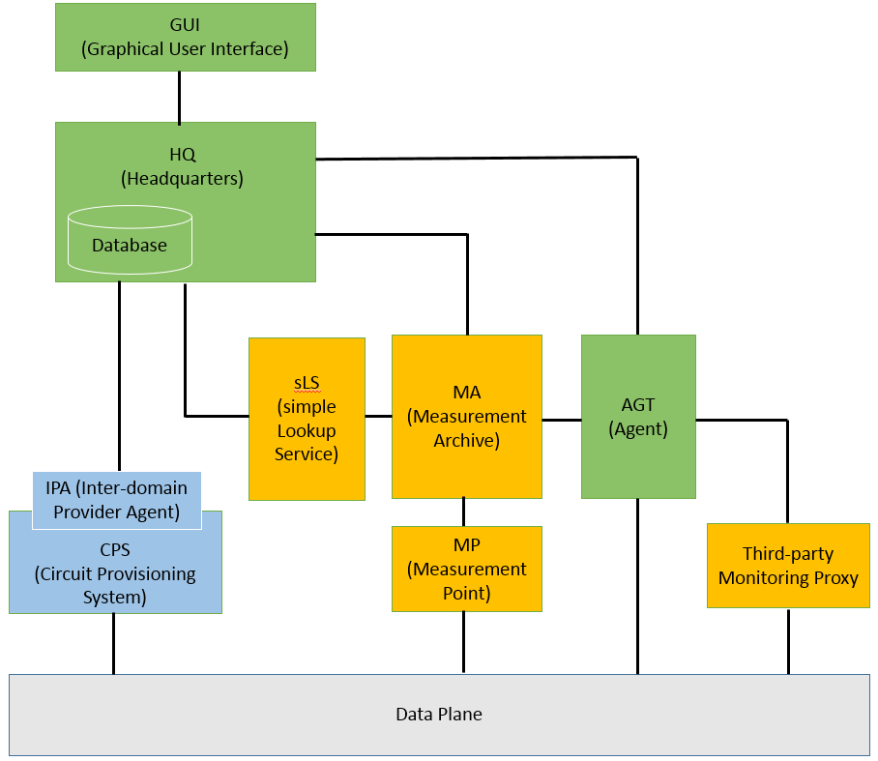
CMon – Architecture
Central and distributed modules
Well-defined interfaces between modules
Loosely coupled
Scalable

Slide 6
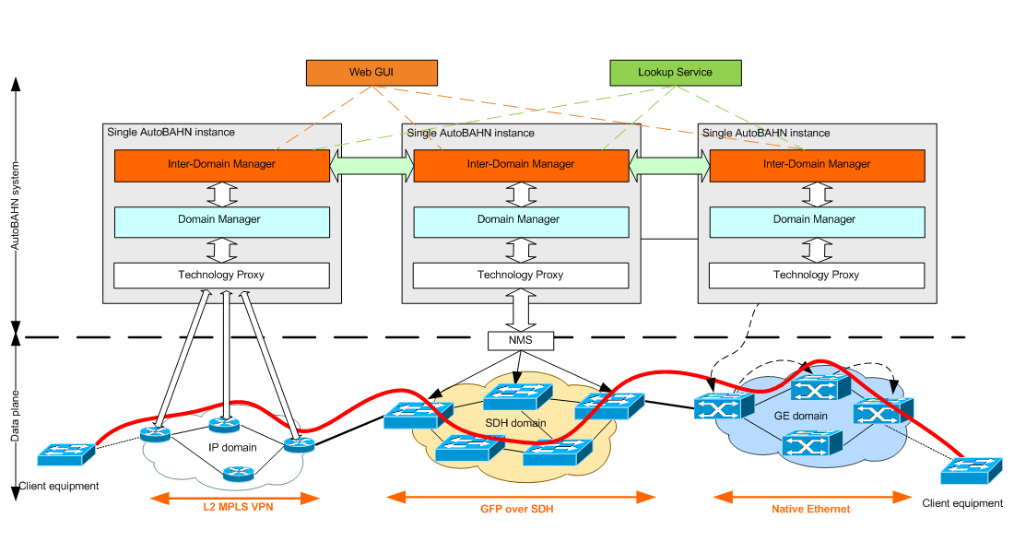
Example Provisioning System
BoD – AutoBAHN
Request circuits on-demand
Components:
GUI, IDM, DM, TS
Helper modules: TP, cNIS

Slide 7
CMon – Information Workflow
Circuit Notification
Starts at circuit request
HQ receives circuit meta data
Circuit Monitoring
Starts when circuit is established
Agent starts collecting data in each
domain
Circuit Termination
Manually or automatically
HQ receives notification

Slide 8
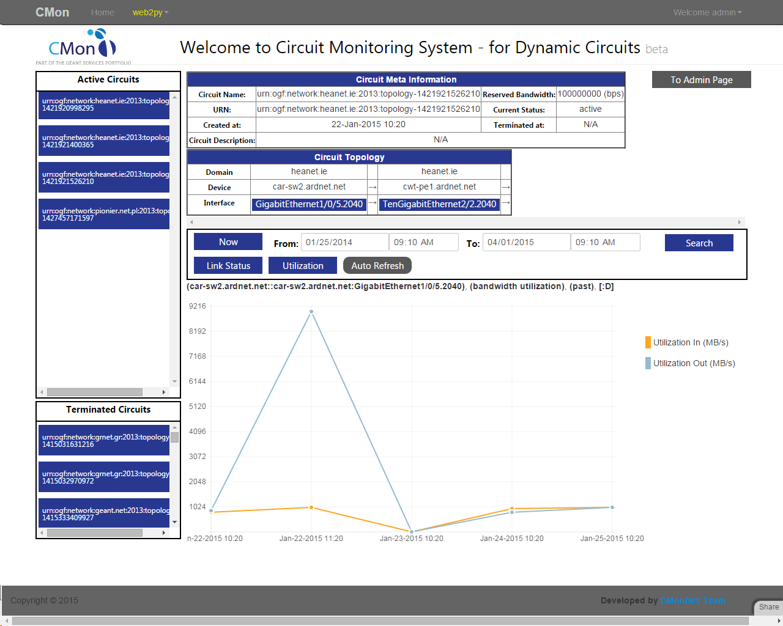
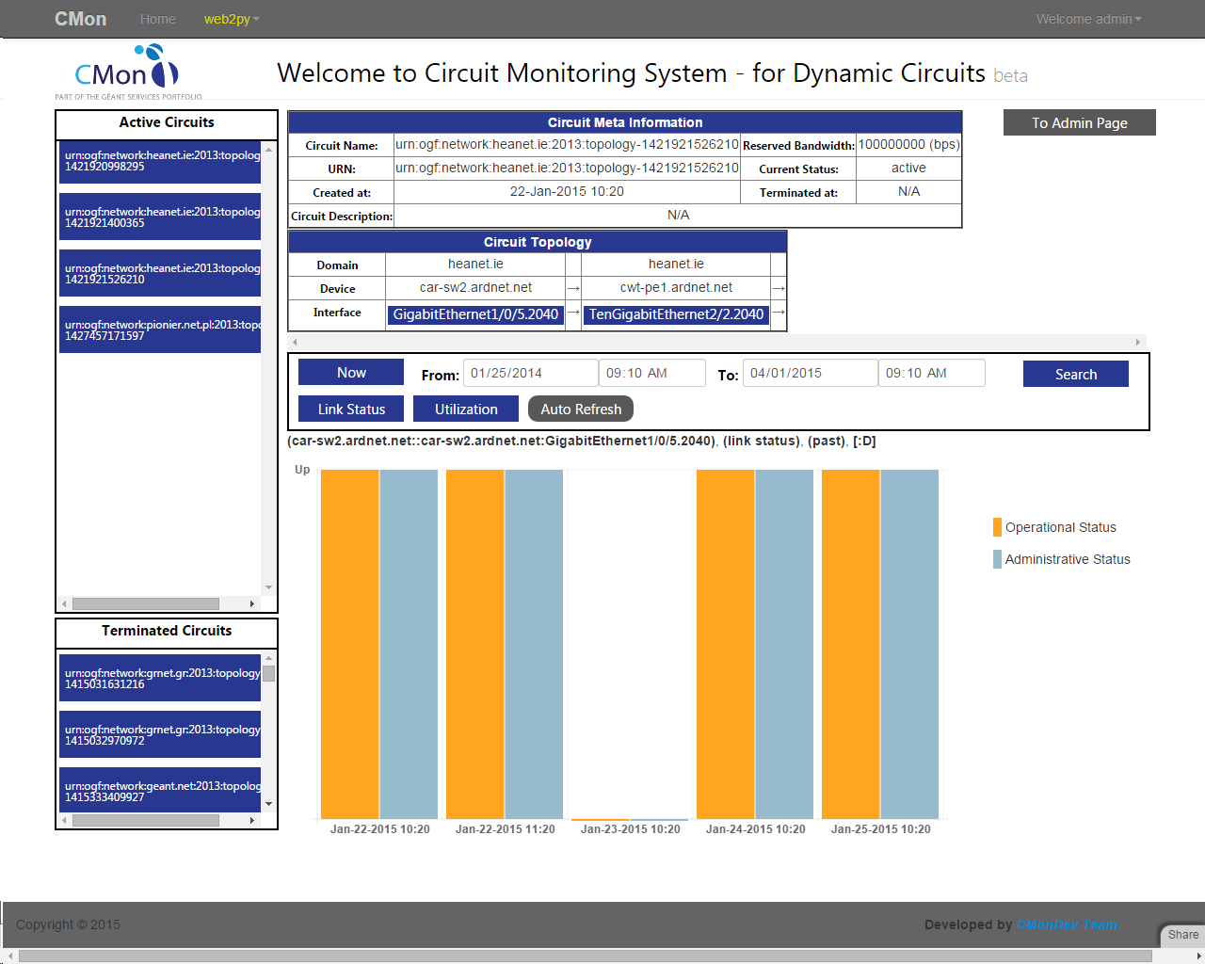
CMon - Screenshots

Slide 9
CMon – Design Considerations
Advantages
Simple, scalable
Highly modularised
Each module is lightweight
Independent of other modules as long as interface between them is unchanged
No-SQL database used
Designed to use already in-place monitoring methods

Slide 10
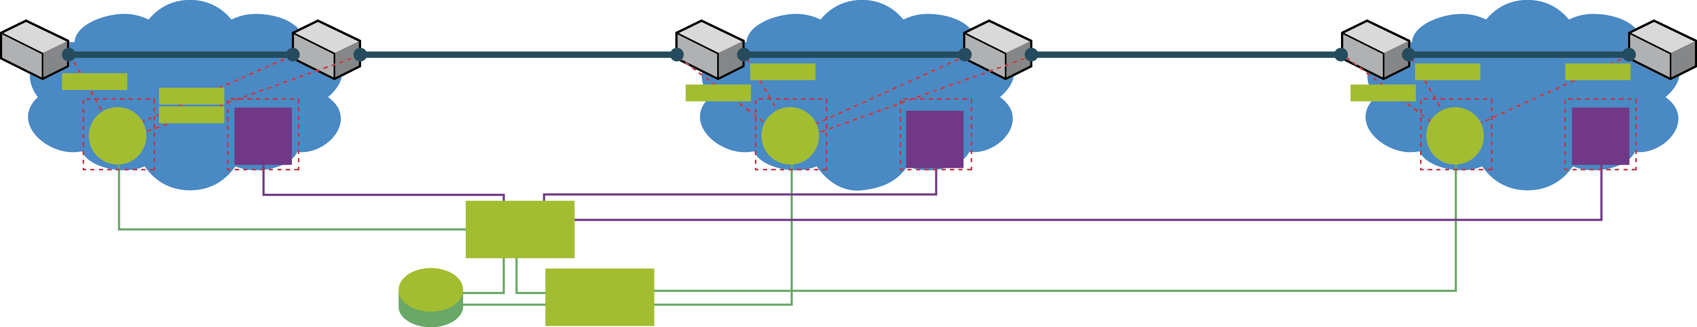
CMon - Current Status
PIONIER
GÉANT
HEANET
polls
traps
polls
polls
polls
polls
traps
Agent
polls
IDM
Agent
Agent
IDM
IDM
VM:sqf-234669
VM:test-cmon-agent
VM:tiga
HQ
Web GUI
More NRENs signing up
Catering to static user panel
Evaluating integration with other monitoring systems…

Slide 11

CMon – Outside GÉANT
CMon paper published in IEEE Commns. Magazine
May 2014 issue: Monitoring and Troubleshooting
Multi-Domain Networks using Measurement Federations
Presentation at TNC 2014
Also published as a full paper
Poster at TNC15
In talks for global collaboration
Following on the perfSONAR workshop in 2014

Slide 12
Future Plans, Conclusion
Incorporate other monitoring methods, cover more use cases…
Interface with a trouble ticketing system
Participate in framework creation, standardisation
Offer CMon as a standalone service, and as a part of multi-domain monitoring suite
For more
https://forge.geant.net/forge/display/cmon/Home
Email us: cmon-dev@geant.net
Participate in pilot and beyond
Collaboration, Ideas
http://www.terena.org/publications/tnc2014-proceedings/
CMon GUI: http://test-cmon-gui.geant.net (demo / demo)
Register!

Slide 13
trupti.kulkarni@geant.org

